Slide 1
Recognizing Scene Viewpoint using Panoramic Place Representation
Jianxiong Xiao Krista A. Ehinger Aude Oliva Antonio Torralba
http://sun360.mit.edu

Slide 2
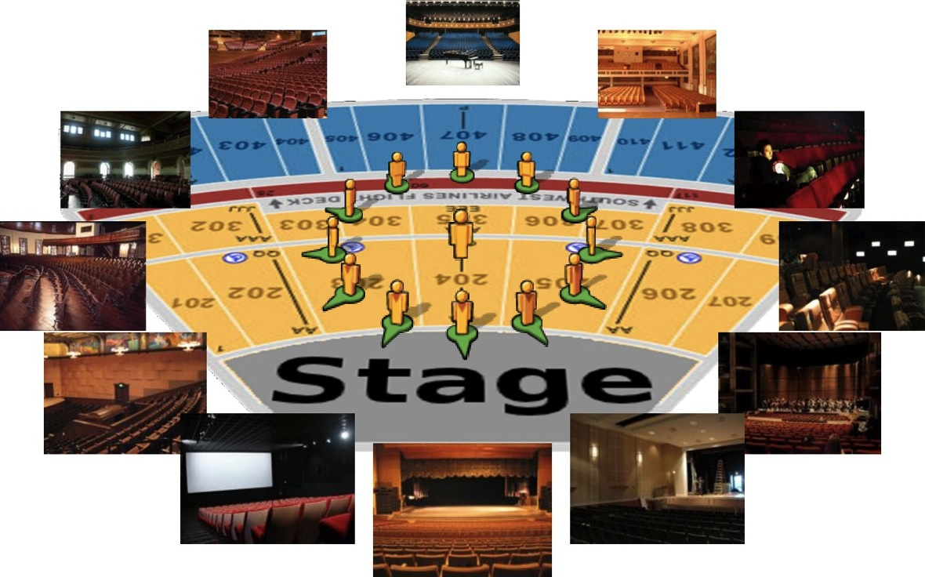
Scene Viewpoint Recognition
Notes:
One very important, but mostly-ignored visual task for scene understanding is to recognize the viewpoints of the scenes.
Look at here. Imagine that you are standing inside a theater.
Despite belonging to the same place category, the photos taken by an observer inside a place look very different from different viewpoints.
This is because typical photos have a limited visual field of view and only capture a single scene viewpoint at a time.

Slide 3
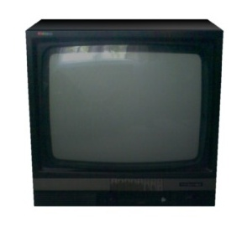
Object Pose Recognition
Notes:
Same for objects. Let’s say you want to watch TV now. First of all, you need to recognize that this object is a TV so that you can turn it on.
But also, you need to recognize and choose a viewpoint to see this object. For example, this view is good for TV watching.
But if you cannot recognize the viewpoint of the TV, some funny things can happen.

Slide 4
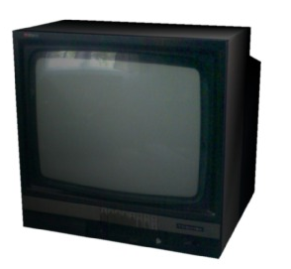
Object Pose Recognition

Slide 5
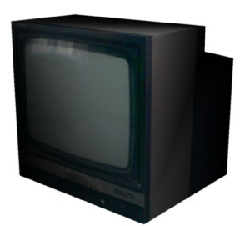
Object Pose Recognition

Slide 6
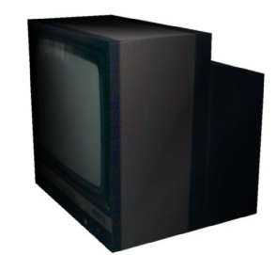
Object Pose Recognition

Slide 7
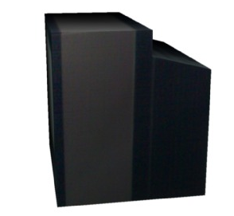
Object Pose Recognition

Slide 8
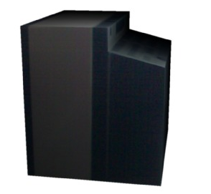
Object Pose Recognition

Slide 9
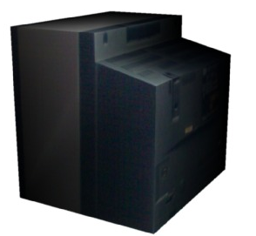
Object Pose Recognition

Slide 10
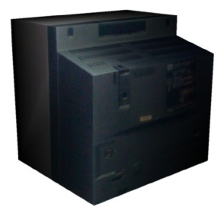
Object Pose Recognition

Slide 11
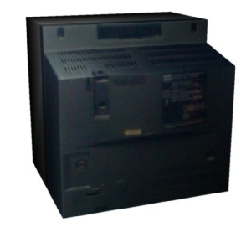
Object Pose Recognition

Slide 12
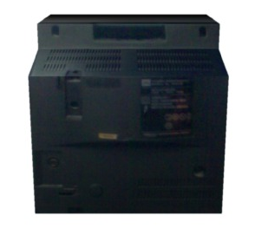
Object Pose Recognition
Notes:
For example, you cannot really watch TV when you are looking at the back of the TV.

Slide 13
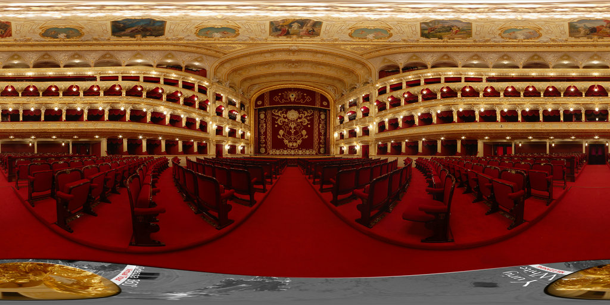
Scene Viewpoint Recognition
Notes:
The same thing happens for scenes. Here is a panorama of a theater. When you want to watch a show in the theater, naturally,

Slide 14
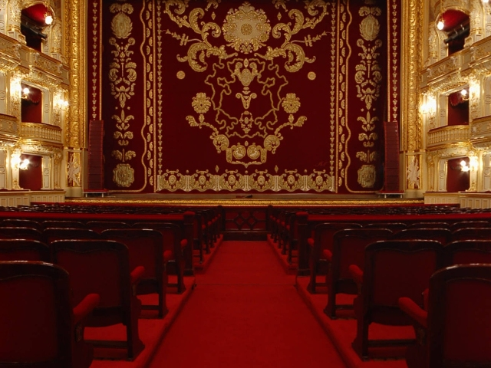
Scene Viewpoint Recognition
Notes:
You want to face towards the stage to be able to see the performance. If you turn your head, you will see very different things,

Slide 15
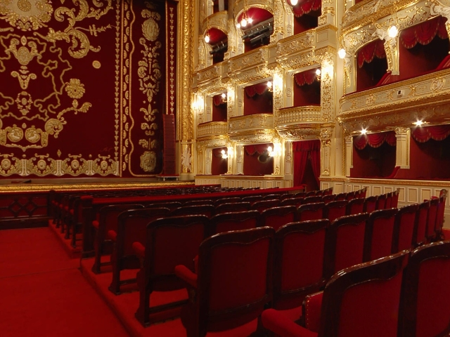
Scene Viewpoint Recognition

Slide 16
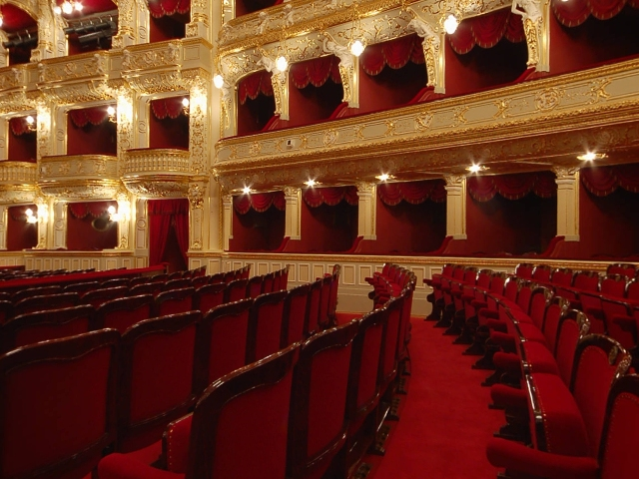
Scene Viewpoint Recognition

Slide 17
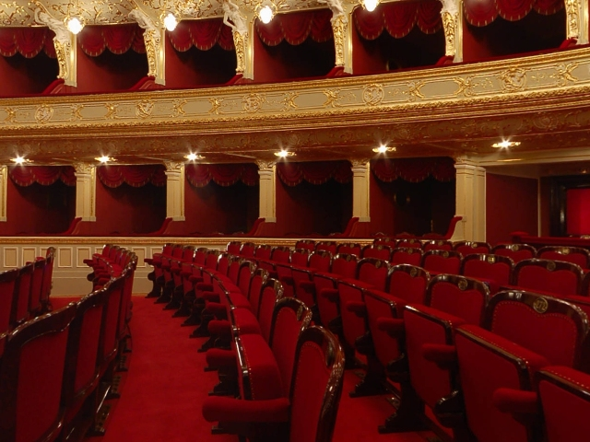
Scene Viewpoint Recognition

Slide 18
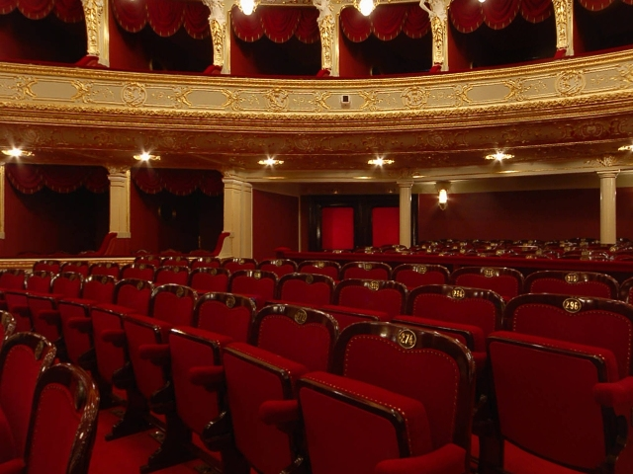
Scene Viewpoint Recognition

Slide 19
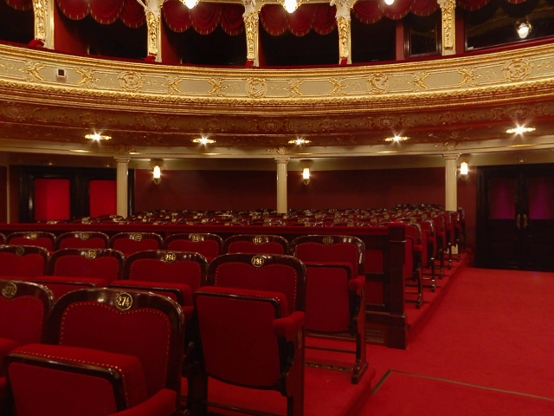
Scene Viewpoint Recognition

Slide 20
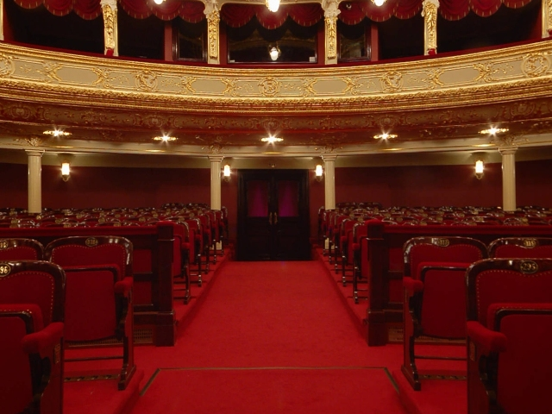
Scene Viewpoint Recognition
Notes:
For example, If you want to go home, probably you want to move towards this way.

Slide 21
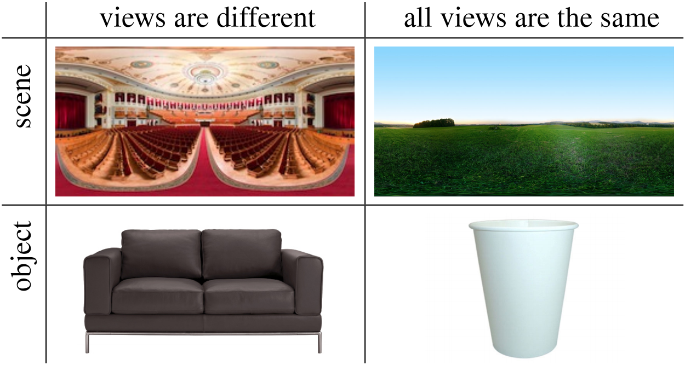
Notes:
Here, we want to acknowledge that, same as objects, certain places exhibit rotational symmetry. For example, an observer standing in an open field can turn and see a nearly-identical view in every direction. Similarly, a cup presents similar views when it is rotated. Other objects and places do not have rotational symmetry, but present some views that are mirror images of each other (left and right sides of the sofa, left and right views of the theater).

Slide 22
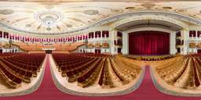
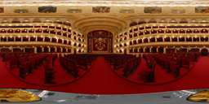
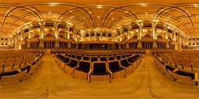
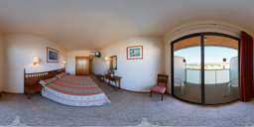
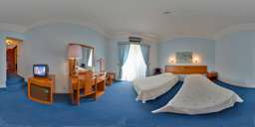
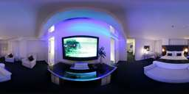
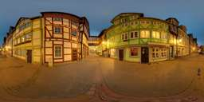
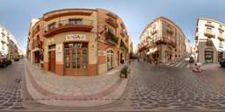
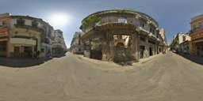
Place categorization & viewpoint recognition
theater
hotel room
street
http://sun360.mit.edu
Notes:
So, want to build a place categorization and viewpoint recognition model.
We use panoramas for training, because they densely cover all possible views within a place.
Here, we have defined a list of place categories, and in each category, there are some panorama images.
We download panorama images from the internet, and label the categories. And we call this dataset SUN360 panorama dataset.
There are 80 place categories in total, and we use 26 categories in the following experiments.

Slide 23
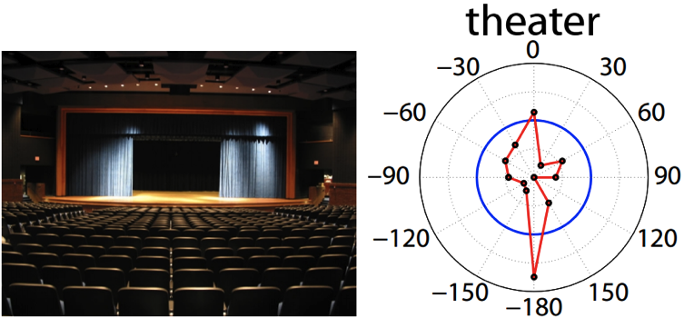
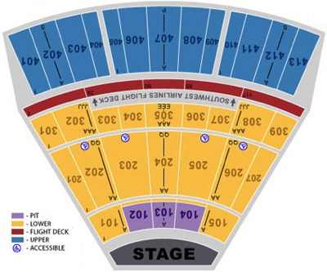
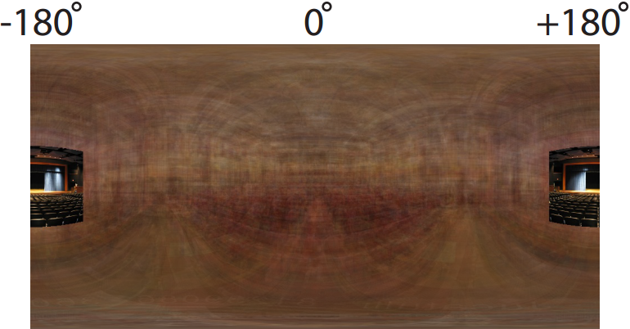
Testing Time
Notes:
During testing, given a limited-field-of-view photo as testing input, our model recognizes the place category, and produces a compass-like prediction of the observer’s viewpoint. Superimposing the photo on an averaged panorama of many theaters, we can automatically predict the possible layout that extends beyond the available field of view.

Slide 24
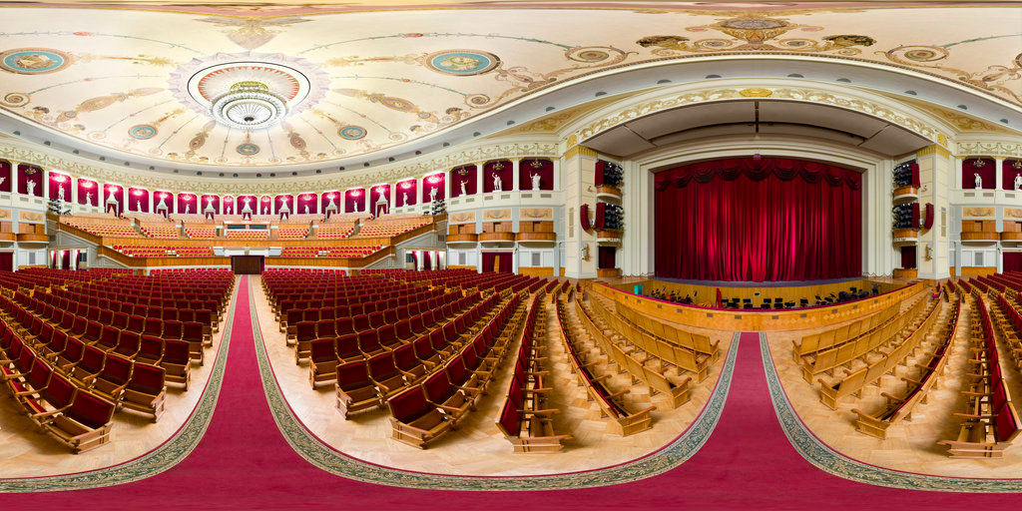
Sample Normal Photos from Panorama
Notes:
As we just mentioned, we want use panorama for training, and use normal photos for testing.
http://sun360.csail.mit.edu/code/cvpr2012pano_codeRelease/data/sun360/image/indoor/theater/crop/pano_afrdtnshvydhca/
http://sun360.csail.mit.edu/code/cvpr2012pano_codeRelease/data/sun360/image/indoor/theater/crop/pano_ahsqnkomwzsblv/
http://sun360.csail.mit.edu/code/cvpr2012pano_codeRelease/data/sun360/image/indoor/theater/crop/more_arsbaqfspfghnn/
http://sun360.csail.mit.edu/code/cvpr2012pano_codeRelease/data/sun360/image/indoor/theater/crop/pano_auhbdigkjsgbnd/

Slide 25
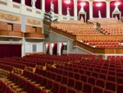
Sample Normal Photos from Panorama
Notes:
To make this happen, we can sample normal photos from the panorama.
http://sun360.csail.mit.edu/code/cvpr2012pano_codeRelease/data/sun360/image/indoor/theater/crop/pano_afrdtnshvydhca/
http://sun360.csail.mit.edu/code/cvpr2012pano_codeRelease/data/sun360/image/indoor/theater/crop/pano_ahsqnkomwzsblv/
http://sun360.csail.mit.edu/code/cvpr2012pano_codeRelease/data/sun360/image/indoor/theater/crop/more_arsbaqfspfghnn/
http://sun360.csail.mit.edu/code/cvpr2012pano_codeRelease/data/sun360/image/indoor/theater/crop/pano_auhbdigkjsgbnd/

Slide 26
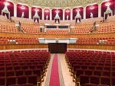
Sample Normal Photos from Panorama
Notes:
. There are some simply geometric transformation we need to take care of. But it is very straight forward.

Slide 27
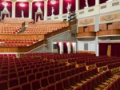
Sample Normal Photos from Panorama
Notes:
There are several good things to sample photos from panorama:

Slide 28
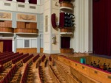
Sample Normal Photos from Panorama
Notes:
First of all, we can unbiasly cover all the viewpoints we want. We can get equal number of training images from each viewpoint.

Slide 29
Sample Normal Photos from Panorama
Notes:
Secondly, when we sample the photos, we can know their viewpoint relations among themselves perfectly.

Slide 30
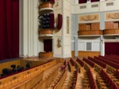
Sample Normal Photos from Panorama
Notes:
As we shall see later, this viewpoint relationship constraint is actually very helpful in the training.

Slide 31
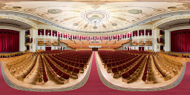
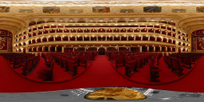
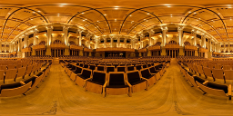
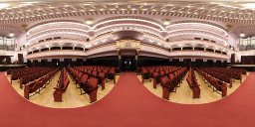
Aligned Panorama
Notes:
Okay, let say that we have a list of panorama images. If they are all aligned well,

Slide 32
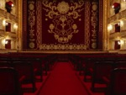
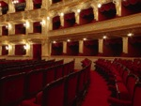
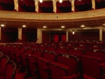
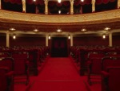
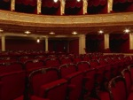
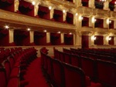
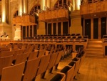
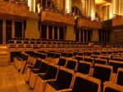
Viewpoint classifier
Notes:
We can sample normal photos from the panoramas,

Slide 33
Viewpoint classifier
SVM
SVM
SVM
SVM
SVM
SVM
Notes:
Then, we can train a viewpoint classification model using the photos sampled from different viewpoints.
For example, we can use all the stages to train a stage view classifier.

Slide 34
Unaligned Views
Notes:
But, alignment among panoramas is a very tedious task for human to label. And it is also very unclear how to label it well. Ideally, we want the computer to figure it out by itself. So, here is the actual situation for training. We have a list of unaligned panoramas, and their sampled photos.

Slide 35
Panorama Alignment
Notes:
We want the algorithm to align the panoramas automatically during training.

Slide 36
Panorama alignment & viewpoint classifier
SVM
SVM
SVM
SVM
SVM
SVM
Notes:
And simultaneously train a viewpoint classifier for each view.

Slide 37
Problem Definition
Place Categorization
Viewpoint Recognition
Notes:
But, viewpoint only makes sense for a specific place category. For example, this compass-like pointer only makes sense to point to this way, because it knows that it is inside a theater. So, the problem is a joint problem of place categorization and viewpoint recognition. But, pay attention here that we call it place instead of scene.

Slide 38
Definition of Scene
Place+Viewpoint VS Scene
s/stage/indoor
t/theater/indoor_seats
t/theater/indoor_round
t/theater/indoor_procenium
o/orchestra_pit
c/catwalk
…
Theater-related Categories in SUN
What about unnamable viewpoints?
Notes:
Because we want to make a distinction against the traditional definition of scene, which is just a name for a scene photo. Here, we want to definite a scene as a place category plus a viewpoint. For example, it is a theater, and it is facing towards this way. On the other side, here is an incompletely list of theater-related scene categories from our SUN database, which is extracted from a dictionary. We can see that this list is quite messy. It messes up place category and viewpoint all the time. Furthermore [click], it doesn’t have any unnamable viewpoints. By defining scenes as a place category plus a viewpoint, we make things much clearer now.

Slide 39
Algorithm Pipeline
Step 1: Place Categorization
Step 2: Panorama alignment & viewpoint classifier
Notes:
So, to make thing clear and simple, the pipeline of our algorithm look like this. The first step is place categorization. And the second step is to align the panoramas and train a viewpoint classifier simultaneously.

Slide 40
Place Categorization
classifier
theater VS hotel room
Notes:
For the first step, place categorization, it is very simple. For each category, we just sample many normal photos from the panoramas, ignored any viewpoint information, and put them all together into a non-linear classifier for training the place classification model. Because we use a non-linear classifier, we can rely on the classifier to figure out the complicated decision boundary without worrying much about the viewpoint.
http://sun360.csail.mit.edu/code/cvpr2012pano_codeRelease/data/sun360/image/indoor/hotel_room/crop/pano_abyappsggwmhqr/
http://sun360.csail.mit.edu/code/cvpr2012pano_codeRelease/data/sun360/image/indoor/hotel_room/crop/pano_afdvjvlfmbgtcy/

Slide 41
Panorama alignment & viewpoint classifier
Notes:
For the Second step, for each category, our input is a list of unaligned images. And we want to align them and train the viewpoint classifier.
http://sun360.csail.mit.edu/code/cvpr2012pano_codeRelease/data/sun360/image/indoor/theater/crop/pano_afrdtnshvydhca/
http://sun360.csail.mit.edu/code/cvpr2012pano_codeRelease/data/sun360/image/indoor/theater/crop/pano_ahsqnkomwzsblv/
http://sun360.csail.mit.edu/code/cvpr2012pano_codeRelease/data/sun360/image/indoor/theater/crop/more_arsbaqfspfghnn/
http://sun360.csail.mit.edu/code/cvpr2012pano_codeRelease/data/sun360/image/indoor/theater/crop/pano_auhbdigkjsgbnd/

Slide 42
Panorama alignment & viewpoint classifier
…
candidate panoramas for training
Notes:
Let’s denote each panorama as a big box in this illustration.

Slide 43
Panorama alignment & viewpoint classifier
…
candidate panoramas for training
Notes:
And these small boxes means the normal field of view photos sampled from the panorama.

Slide 44
Panorama alignment & viewpoint classifier
Iteration 1
panoramas being used
Notes:
For the first iteration of the algorithm, we use only one panorama for training. Because there is only one panorama, there is no need for any alignment.

Slide 45
Panorama alignment & viewpoint classifier
Iteration 1
panoramas being used
SVM
SVM
SVM
Notes:
Therefore, we can train a viewpoint classifier using one training example from each view.

Slide 46
Panorama alignment & viewpoint classifier
Iteration 1
panoramas being used
SVM
SVM
SVM
…
candidate panoramas for training
Notes:
Now, we use this viewpoint classifier to predict the viewpoint for other training panoramas.

Slide 47
Panorama alignment & viewpoint classifier
Iteration 1
panoramas being used
SVM
SVM
SVM
…
confidence
candidate panoramas for training
confidence
confidence
Notes:
Also, we can define and get an overall confident score for each panorama. [click]
And rank them according to their overall prediction confidence.

Slide 48
Panorama alignment & viewpoint classifier
Iteration 1
panoramas being used
SVM
SVM
SVM
…
confidence
candidate panoramas for training
confidence
confidence
Notes:
We pick the most confident panorma

Slide 49
Panorama alignment & viewpoint classifier
Iteration 1
Iteration 2
panoramas being used
panoramas being used
SVM
SVM
SVM
SVM
SVM
SVM
…
confidence
candidate panoramas for training
confidence
Each
Iteration:
1. predict with current SVM
2. add the most confident prediction
3. re-train SVM
confidence
Notes:
And add it into the training set.

Slide 50
Panorama alignment & viewpoint classifier
Iteration 1
Iteration 2
panoramas being used
panoramas being used
SVM
SVM
SVM
re-train SVM
SVM
SVM
SVM
…
confidence
candidate panoramas for training
confidence
Each
Iteration:
1. predict with current SVM
2. add the most confident prediction
3. re-train SVM
confidence
Notes:
And we can re-train the SVM for viewpoint classication, using two examples for each viewpoint this time.

Slide 51
Panorama alignment & viewpoint classifier
Iteration 1
Iteration 2
panoramas being used
panoramas being used
SVM
SVM
SVM
re-train SVM
SVM
SVM
SVM
…
confidence
…
confidence
candidate panoramas for training
candidate panoramas for training
confidence
confidence
Each
Iteration:
1. predict with current SVM
2. add the most confident prediction
3. re-train SVM
confidence

Slide 52
Panorama alignment & viewpoint classifier
Iteration 1
Iteration 2
panoramas being used
panoramas being used
SVM
SVM
SVM
re-train SVM
SVM
SVM
SVM
…
confidence
…
confidence
candidate panoramas for training
candidate panoramas for training
confidence
confidence
Each
Iteration:
1. predict with current SVM
2. add the most confident prediction
3. re-train SVM
confidence
Notes:
And we can predict on the remaining candidate panoramas for training. And do the same thing again.

Slide 53
Panorama alignment & viewpoint classifier
Iteration t
…
panoramas being used
…
candidate panoramas for training
Notes:
So, in a math induction language, at the t-th iteration, we have already aligned many panoramas.

Slide 54
Panorama alignment & viewpoint classifier
Iteration t
…
panoramas being used
SVM
SVM
SVM
…
candidate panoramas for training
Notes:
We can then train a viewpoint classifier for each view using the aligned views.

Slide 55
Panorama alignment & viewpoint classifier
Iteration t
…
panoramas being used
SVM
SVM
SVM
…
confidence
candidate panoramas for training
confidence
confidence
Notes:
Predict on the remaining training candidates.

Slide 56
Panorama alignment & viewpoint classifier
Iteration t
…
panoramas being used
SVM
SVM
SVM
…
confidence
candidate panoramas for training
confidence
confidence
Notes:
Pick the most confident prediction.

Slide 57
Panorama alignment & viewpoint classifier
Iteration t
Iteration t+1
…
…
panoramas being used
panoramas being used
SVM
SVM
SVM
re-train SVM
SVM
SVM
SVM
…
confidence
…
candidate panoramas for training
candidate panoramas for training
confidence
Each
Iteration:
1. predict with current SVM
2. add the most confident prediction
3. re-train SVM
confidence
Notes:
Add it into the training pool with the predicted alignement, and then re-train the model

Slide 58
Panorama alignment & viewpoint classifier
Iteration t
Iteration t+1
…
…
panoramas being used
panoramas being used
SVM
SVM
SVM
re-train SVM
SVM
SVM
SVM
…
confidence
…
confidence
candidate panoramas for training
candidate panoramas for training
confidence
confidence
Each
Iteration:
1. predict with current SVM
2. add the most confident prediction
3. re-train SVM
confidence
Notes:
And do the same thing again.

Slide 59
Details
Exploits the fact that the most confident prediction of SVM is usually correct.
Exhaustively try each panorama as the starting point.
Viewpoint relation as hard constraints.
Adjust all the previously used training panoramas according to the current classifier.
Align both the original panorama and a horizontally-flipped version of the same panorama.
Curriculum learning: quantity and difficulty.
Notes:
Here are some details about the algorithm about why it works well, how to initialize it, and how it is related to curriculum learning.

Slide 60
Algorithm Analysis
Maximum-likelihood Interpretation
k-means and EM
Latent Structural SVM with CCCP
Joint probability
Training
Testing
Alignment step
Maximization step

Slide 61
Algorithm Analysis
Maximum-likelihood Interpretation
k-means and EM
Latent Structural SVM with CCCP
http://sun360.mit.edu

Slide 62
Symmetry Property of Scenes
Notes:
We also study the symmetry property of scenes. We define four common types of symmetry we find in real world. Type I symmetry is simply no symmetry at all. Type II symmetry is bilateral symmetry with one axis. For example, if you flip this panorama horizontally, we see the same image. The red line is the symmetry axis. Type III symmetry is the bilateral symmetry with two axes. And Type IV symmetry is the isotropic symmetry that we discussed before.

Slide 63
Notes:
Here are some examples for each type of the symmetry. Each row is one type. And each column is an images corresponding to each viewpoint, shown as a clock here. The first row is the type I symmetry.

Slide 64
A
B
Notes:
The second row is the type II symmetry, the bilateral symmetry with one axis. For example, here, the image A and B have similar structure when they are flipped horizontally.

Slide 65
A
B
Notes:
For example, the coast lines are bilaterally symmetric.

Slide 66
C
A
B
D
Notes:
The third row shows the isotropic symmetry with two axies. The four photos shown here have similar structure.

Slide 67
C
A
B
D
Notes:
Look like this.

Slide 68
restaurant lobby atrium museum
field expo showroom mountain
forest old building park
cave ruin workshop
Notes:
For the Type 4 symmetry, the isotropic symmetry with nearly identical view, here we show the average panorama image from our dataset. For example, the views look very similary across different viewpoints.

Slide 69
View Sharing Under Symmetry
I
Notes:
If we know the symmetry structure of a place, we can actually share the training example across different views. For type I, there is no symmetry, so there is no sharing across view. So all these little boxes have the different colors in this illustration.

Slide 70
View Sharing Under Symmetry
I
II
A
B
Notes:
For type II, any two symmetric views can share their training data. So that we can double the size the training data to make the algorithm works better.

Slide 71
View Sharing Under Symmetry
I
II
III
A
B
C
A
B
D
Notes:
For type III symmetry, the same thing happens, but with even more sharing.

Slide 72
View Sharing Under Symmetry
I
II
III
IV
A
B
C
A
B
D
Notes:
For type IV, because all views are nearly identical. We can do nothing better than random guess.

Slide 73
Symmetry Axis Discovery
I
II
III
IV
A
B
C
A
B
D
Notes:
For type II and type III, to discovery the symmetry axis automatically, in each iteration of the algorithm [click], we exhaustively search for the symmetry axis to maximize the joint confidence from our viewpoint classifiers.

Slide 74
Symmetry Axis Discovery
I
II
III
IV
A
B
C
A
B
D
Notes:
For type III symmetry, because we assume the two symmetry axes are perpendicular with each other, the search space is even smaller.

Slide 75
Symmetry Type Discovery
I
II
III
IV
A
B
C
A
B
D
Notes:
To determine the symmetry type, we simply use cross-validation to pick the type with the best performance.

Slide 76
Evaluation
Evaluation methods
Evaluation on training
Evaluation on testing
Notes:
We have covered the algorithm. The next topic is how to evaluate it.

Slide 77
Evaluation
Evaluation methods
Viewpoint classification accuracy
Average viewpoint angle deviation
Oracle (Unsupervised Object Discovery)
assign each aligned viewpoint to one of the directions
evaluate based on the resultant view-to-view mapping
Evaluation on training
Evaluation on testing
Notes:
Because it is a new problem, we need to define our evaluation methods first. As we model the viewpoint prediction as classification problem, the simplest way to evaluate the viewpoint prediction is to just get the accuracy.

Slide 78
Evaluation
Evaluation methods
Viewpoint classification accuracy
Average viewpoint angle deviation
Oracle (Unsupervised Object Discovery)
assign each aligned viewpoint to one of the directions
evaluate based on the resultant view-to-view mapping
Evaluation on training
Evaluation on testing
Notes:
Another evaluate criteria is the average viewpoint angle deviation. Say, the green arrow is the correct viewpoint, and the blue one is the prediction. We can measure the angle between them as a criteria.

Slide 79
Evaluation
Evaluation methods
Viewpoint classification accuracy
Average viewpoint angle deviation
Oracle (Unsupervised Object Discovery)
assign each aligned viewpoint to one of the directions
evaluate based on the resultant view-to-view mapping
Evaluation on training
Evaluation on testing
Notes:
Also, because our algorithm is unsupervisdly aligning the panoramas, we define an oracle to assign each aligned viewpoint to one of the directions, and evaluate based on the resultant view-to-view mapping.

Slide 80
Evaluation
Evaluation methods
Evaluation on training
How far is the automatic alignment from manual alignment?
Evaluation on testing
Notes:
We have two things to evaluate, one for alignment, one for viewpoint prediction. For training, we evaluate how different is the result of our automatic alignment from manual alignment?

Slide 81
Alignment Accuracy
Notes:
Liked I mentioned before, we can evaluate by accuracy. We also design some other algorithms for comparison purpose only. We can see that our algorithm performs the best.

Slide 82
Alignment Angle Deviation
Notes:
If we measure the performance based on the average angle deviation, our algorithm also performs the best against other methods.

Slide 83
Manual Alignment
Notes:
Here is a visualization of the average panoramas using manual alignment. It is a beach. So we can see the water gets aligned here at the center.

Slide 84
Automatic Alignment 84.4%
Notes:
Here is the average panoramas aligned automatically by our algorithm. Compared against the manual alignment, you can see that the results makes a lot of sense because it also aligned very well. All water gets together.

Slide 85
Automatic Alignment 84.4%
Place Centric Panoramic Representation of the Space
Notes:
Here are the automatically discovered symmetry axis. [click] this panorama can also be understood as a place centric panoramic representation of the space.

Slide 86
Random Alignment
Notes:
Here is the average panoramas aligned automatically by our algorithm. Compared against the manual alignment, you can see that the results makes a lot of sense because it also aligned very well. All water gets together.

Slide 87
Manual Alignment
Notes:
Here is the manual alignment for a church.

Slide 88
Automatic Alignment 95.5%
Notes:
The automatic alignment result. For example, here you can see Jesus Christ.

Slide 89
Automatic Alignment 95.5%
Notes:
The discovered symmetry axis.

Slide 90
Random Alignment
Notes:
The automatic alignment result. For example, here you can see Jesus Christ.

Slide 91
Manual Alignment
Notes:
Here is a hotel room. You can see the bed is here. The TV is here. And the window is there

Slide 92
Automatic Alignment 88.5%
Notes:
Here is the automatic result.

Slide 93
Random Alignment
Notes:
Here is the automatic result.

Slide 94
Manual Alignment
Notes:
The algorithm works for outdoor as well. Here is a street scene.

Slide 95
Automatic Alignment 76.6%
Notes:
Here is the automatic results for a street. You can clearly see the buildings on the two side of the streets.

Slide 96
Automatic Alignment 76.6%
Notes:
Here is the discovered symmetry axis. All the the categories I just show performs quite well.

Slide 97
Random Alignment
Notes:
Here is the automatic results for a street. You can clearly see the buildings on the two side of the streets.

Slide 98
Manual Alignment
Notes:
But there are also some more difficult class. For example, here is a coast scene

Slide 99
Automatic Alignment 51.3%
Notes:
And the algorithm performs not as good as other categories. You can see the average images are not so smooth now.

Slide 100
Automatic Alignment 51.3%
Notes:
Here are the symmetry axis. It is still correct.

Slide 101
Random Alignment
Notes:
And the algorithm performs not as good as other categories. You can see the average images are not so smooth now.

Slide 102
Manual Alignment
Notes:
Here is the most difficult category in our dataset: Lawn.

Slide 103
Automatic Alignment 41.7%
Notes:
The alignment doesn’t work very well, probably because of the huge diversity of the images.

Slide 104
Automatic Alignment 41.7%
Notes:
But the symmetry axis still looks correct.

Slide 105
Random Alignment
Notes:
The alignment doesn’t work very well, probably because of the huge diversity of the images.

Slide 106
Evaluation
Evaluation methods
Evaluation on training
Evaluation on testing
Train on SUN360, Test on SUN360
Train on SUN360, Test on SUN
Notes:
We also evaluate on testing. We have two setting. One is to train the model on panorama, and test on the normal field of view images sampled from the panoramas. The other is also to train the model on panorama, but test it on real photos from our SUN database.

Slide 107
Evaluation for Testing
Place Categorization
Viewpoint Recognition
Notes:
Here reports our performance. We evaluate the place classification accuracy, and viewpoint recognition accuracy separately.

Slide 108
Evaluation for Testing
Place Categorization
Viewpoint Recognition
Notes:
We also evaluate their joint accuracy. That means a prediction is correct, if and only if the place category prediction and the viewpoint prediction are both correct. We compare our algorithm against the model trained from ground truth manual alignment. We can see the results are actually very close.

Slide 109
Viewpoint Prediction Accuracy
Test on SUN360
Test on SUN
Impose correct symmetry structure is usually helpful
even when the imposed symmetry is incomplete
Imposing incorrect types of symmetry always hurts performance
Notes:
Here is the visualization of the performance under different symmetry structure assumption. We can see that …

Slide 110
Visualization of Results
Notes:
Here is some visualization of the result. The first columns show the input photo during the testing time. The second columns shows a compass-like prediction score for the viewpoint. It is actually the score we got from the SVM viewpoint classifier. The center means -1. Further away from the center means higher score. and the blue circle means zero. The last two columns illustrate the predicted camera orientation and the extrapolated scene layout beyond the input view (the left image extrapolates the layout using the average panorama from the place category; the right image uses the nearest neighbor from the training set.)

Slide 111
Visualization of Results

Slide 112
Visualization of Results

Slide 113
Canonical view of objects
S. Palmer, E. Rosch, and P. Chase. Canonical perspective and the perception of objects.
Attention and Performance IX, 1981.
Notes:
Another thing we study in this project is the canonical view of scenes. It is well-known that objects have canonical views. For example, in 1981, Palmer and others shows that these are the most preferred view for different type of objects.

Slide 114
Canonical view of objects
Notes:
For example, if you search “mug” in google images search, we can get these images. Almost all mugs here have a handle on one side. Especially the right side. We can see that there is clear viewpoint bias.

Slide 115
Canonical view of scenes
The canonical views of different place categories.
Specifically, in which viewpoint people choose when they want to take a photo of a particular type of place.
Notes:
But no one in the literature actually studies this problem for scenes before. Therefore, we take a first step to see if there is also any canonical views for different place categories. More specifically, we study in which viewpoint people choose when they want to take a photo of a particular type of place.

Slide 116
Canonical view of scenes
The canonical views of different place categories.
Specifically, in which viewpoint people choose when they want to take a photo of a particular type of place.
http://sundatabase.mit.edu
Notes:
To do this, for each category, we take the images from our SUN database, which is supposed to be a very good sampling of the visual worlds under natural statistics.

Slide 117
Viewpoint Annotation for Truth
Adjust the view of the panoramic image on the right so that it matches the view shown on the left.
Target View: Panorama: Adjust the view to match the target view.
Amazon Mechanical Turks $0.01 Task.
Notes:
We design a Amazon Mechanical Turk task to ask people to label the viewpoint each SUN images. Given a SUN photo such as this one, we designed an interactive panorama viewer on the right using Adobe Flash. And we ask them to click and drug the panorama in the viewer, to adjust the view so that it matches the view shown on the left. In this way, we can get the viewpoint labeling for the SUN photos.

Slide 118
Canonical Viewpoint of Scenes
Notes:
Here are the result.

Slide 119
Canonical Viewpoint of Scenes
Notes:
For example, for hotel room, here is the histogram of the number of the images distributed across different viewpoints, plotted in the polar coordinate. The up direction corresponds to the center of the panorama, which corresponds to the door way of the hotel room. We can see that there is clear preference towards to this viewpoint, which corresponds to the bed. In another word, this means that the canonical view of a hotel room is the views that have the bed inside. Which makes a lot of sense.

Slide 120
Canonical Viewpoint of Scenes
Notes:
Here is a beach scene. We can see that there is clear preference towards the water part of the beach. And it also tends to be parallel or perpendicular to the coast line.
This is very reasonable because when most people take a picture of a beach, we would expect that they have some water inside the picture to make a typical beach photo.

Slide 121
Canonical Viewpoint of Scenes
Notes:
Here is a theater. There is a strong preference towards the stage.

Slide 122
Canonical Viewpoint of Scenes
Notes:
Here is a train. There is strong preference to the direction parallel to the train.

Slide 123
Canonical Viewpoint of Scenes
Notes:
And here is wharf scene. Again, there is a strong preference towards the water.

Slide 124
Correlation of views and SUN categories
How each view is correlated with specific SUN scene categories?
Use our SUN 397-category classifier.
Predict on each viewpoint of the panorama and get an average response.

Slide 125
sandbar
islet
beach
snowfield
desert/sand
Notes:
Here are top 5 highest score SUN categories for this viewpoint. We can see that it makes a lot of sense to predict sandbar, islet, and beach.

Slide 126
volleyball court/outdoor
residential neighborhood
bridge
putting green
construction site
Notes:
Here is another view. Without water, the categories in this view change a lot. They are now volleyball court and residential neighborhood, and even construction site.

Slide 127
sandbar
islet
beach
snowfield
desert/sand
beach
desert/sand
snowfield
residential neighborhood
islet
volleyball court/outdoor
residential neighborhood
bridge
putting green
construction site
Notes:
And in the middle, we have both beach and residential neighborhood.

Slide 128
laundromat
videostore
sushi bar
restaurant
movie theater/indoor
movie theater/indoor
theater/indoor seats
auditorium
theater/indoor procenium
conference center
museum/indoor
stage/indoor
theater/indoor procenium
movie theater/indoor
subway station/platform
Notes:
Here is another example, Towards this direction, it is call movie theater, towards this direction, it is stage.

Slide 129
Image Extrapolation
Notes:
An interesting application of viewpoint recognition to extrapolate an image. Given an image like this,

Slide 130
Recognize Viewpoint in Scenes
Typical layout of a theater
Predicted Score on Viewpoint
Notes:
we can recognize that it is taken inside a theater, and the camera is facing the seat.

Slide 131
Notes:
We superpose it onto the average panorama of theaters

Slide 132
Notes:
And the nearest neighbor from the training set.

Slide 133
Notes:
Here image you first see at the center is the input picture, and the area surrounding the picture is the extrapolation.
We can clearly see how correct view alignment allows us to predict visual information that extends beyond the boundaries of the test picture. We extrapolate the photo with texture synthesis technique. Here, we use Raj & Rosenholtz 2010 for the texture synthesis.

Slide 134
Notes:
Here is another example. The extrapolated view is produced using texture synthesis algorithm guided by nearest neighbor, which is the most similar panorama.
a version of the Portilla-Simoncelli which operates over local patches of the image.

Slide 135
Notes:
Another example, a TV here,

Slide 136
Notes:
A subway station

Slide 137
Boundary extension
An error of commission in which people confidently remember seeing a surrounding region of a scene that was not visible in the studied view.
H. Intraub and M. Richardson. Wide-angle memories of close-up scenes.
Journal of experimental psychology. Learning, memory, and cognition, 1989.
Notes:
Besides potential computer graphics applications, this is also an interesting visualization for boundary extension effect in cognitive science. Boundary extension is a robust phenomenon that people confidentially remember seeing a surrounding region of a scene that was not visible in the studied view. For example, in the experiment, this picture is shown to a human. Then, the picture is removed, and the subject is asked to draw the picture. No matter who and what picture, human consistently make the mistake to draw a picture larger than it should be, including the surrounding region of a scene.

Slide 138
Notes:
Our visualization is kind of mimicking this effect. Given the picture, the texture synthesis is able to synthesized what is outside the photo.

Slide 139
Notes:
Here shows the extrapolation result of a wharf.

Slide 140
Notes:
Here is a reasonable guess of a church.

Slide 141
Recognizing Scene Viewpoint using Panoramic Place Representation
Jianxiong Xiao Krista A. Ehinger Aude Oliva Antonio Torralba
http://sun360.mit.edu
SUN360 Panorama Database and Source Code Available
Notes:
For more information, please visit our website.

