Slide 1
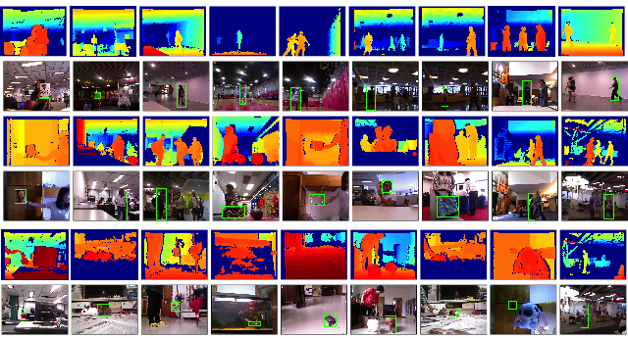
3D Data Helps Tracking
Princeton Tracking Benchmark http://tracking.cs.princeton.edu
Tracking Revisited using RGBD Camera: Unified Benchmark and Baselines. ICCV2013.

Slide 2
3D Data Helps Tracking
3D

Slide 3
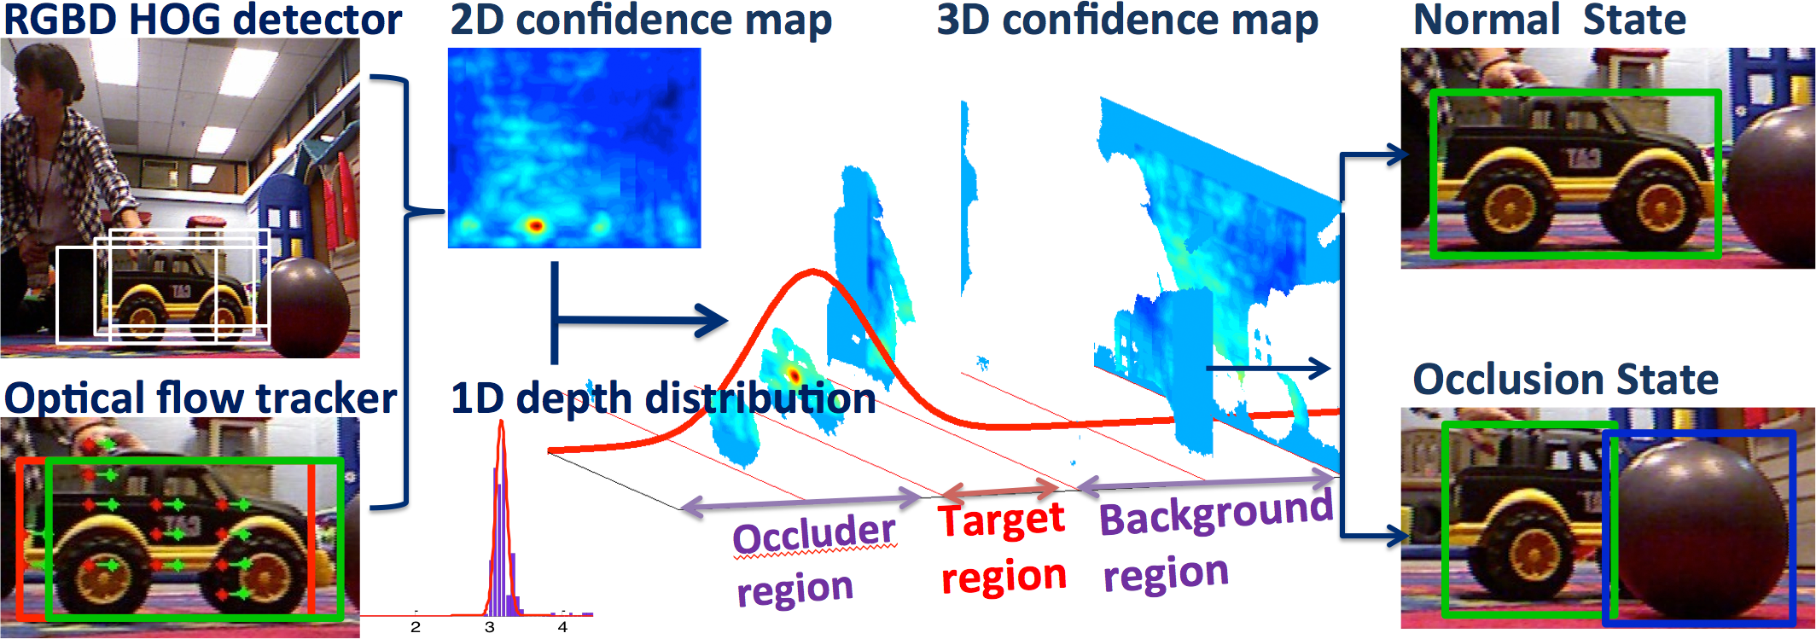
3D Data Helps Occlusion

Slide 4
